Slide 1

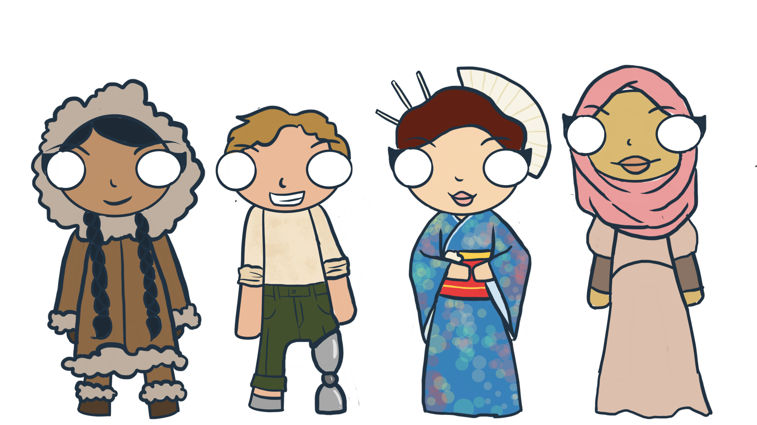

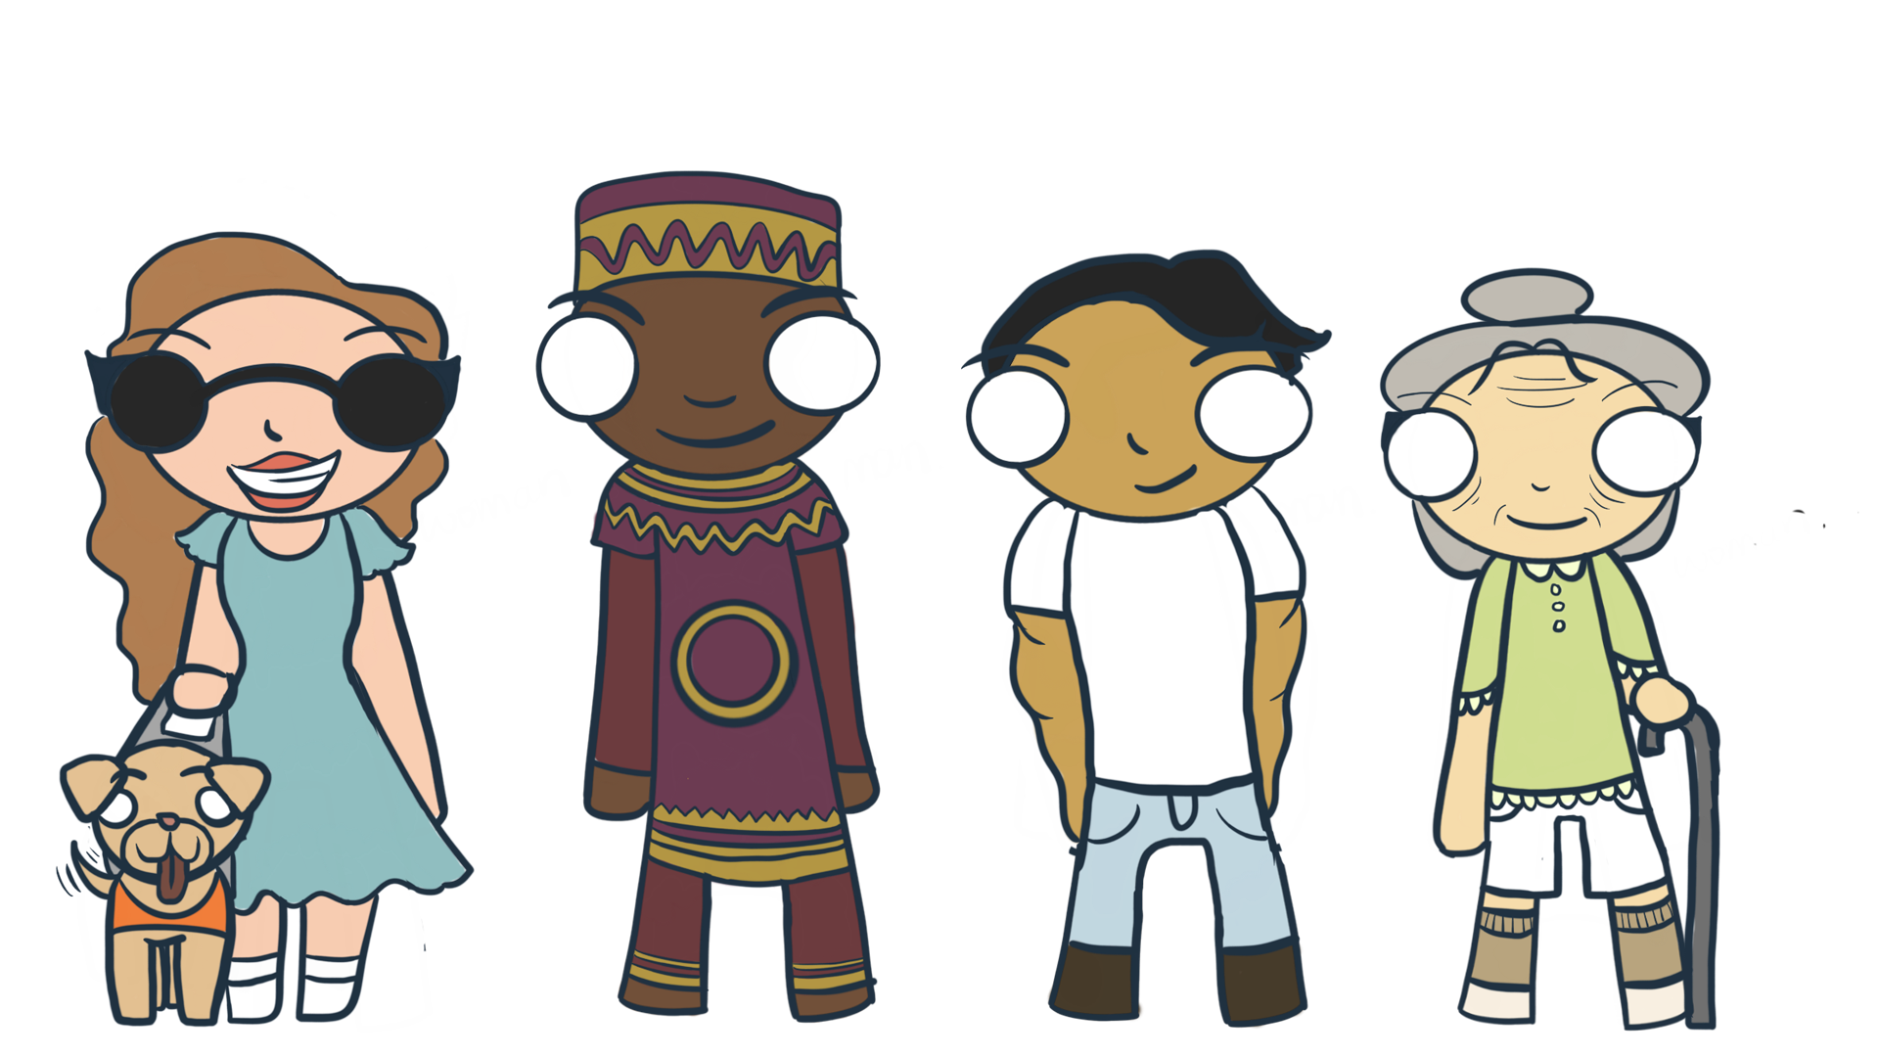
Network Diversity, Equity and Inclusion
Attract at Early Age: STEAM Learning Experience
D,E&I Team
November 2021

Slide 2








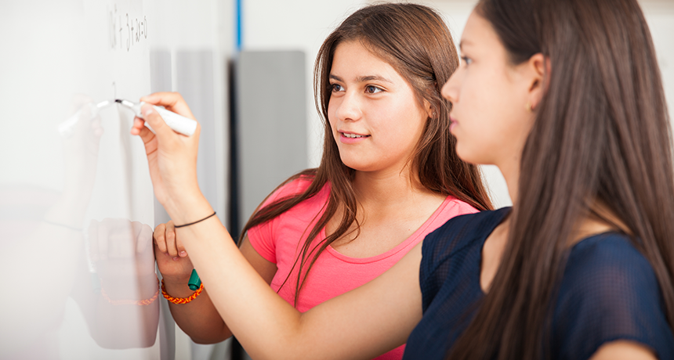
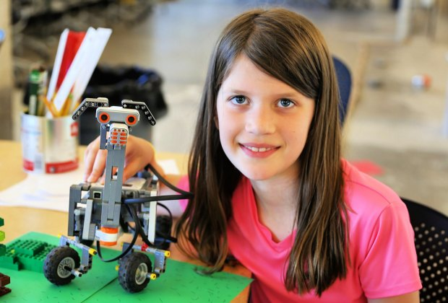


Engage at an early age
How to achieve our vision?
By organizing interactive initiatives in schools and community organizations where young girls can participate in a fun, supportive and encouraging environment that promotes innovative thinking
Our vision is to inspire young girls to pursue STEAM related careers by bringing awareness about technology and opportunities at Bell
STEAM is the abbreviation for Science, Technology, Engineering, Art & Math
It helps students to
Ask questions
Think creatively
Connect the dots
Be innovative
Problem solve
2
It’s an integrated approach to learning that encourages students to think more broadly about real-world problems

Slide 3
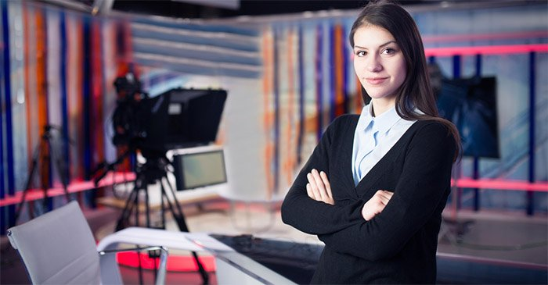








“A journalist at CTV News”
TOPIC
On the day of a journalist at CTV News
Be a Bell Media producer and journalist - VJ!
STEAM focus
Technology & Art
Get Started
Showcase
Certification
get Ready
get Engaged
Students will learn how to do their pitch, their Story ideas and the steps to get the story together for a showcase
Student attend the showcase:
Pitch for their story idea
Showcase their story
Share two learnings
Brief overview of their experience
Students will receive a certification from Bell on the completion of the activity
Email is sent out to all students with assignment for that week watch and/or reading the news
Student apply for a journalist position at CTV
(online form application)
Certification
Get it Done
Day -1
Day 0
Day 1-3
Day 4
Same day
Day 4
December 1st
December 17th
Jan 2022
Students can invite anyone to participate in the group showcase
Jan 2022

Slide 4


1/2 Day Program – Morning Schedule
Attendance: Virtually (using Google Meets)
Other tools: Kahoot (quizzes, games, videos) & White Board
Number of Participants: 10-13
Curriculum:
1 week prior student are asked to apply for a journalist position at CTV (online form application)
1 week prior to starting at CTV News an email is sent out to all the students with assignment for that week watch and/or reading the news.
Day 1 AM – starts at 8:30am to 11:45am
Video - Brief overview of Bell
Trivia Game – Test their existing knowledge
Group Discussion – The solar system of Bell
Discussion – Diversity and Inclusion at Bell
Video – The history of TV, Cinema and Radio science
Discussion - Story pitching during morning stand up
Video – How to find a story
Video – A day in the life of a CTV reporter
Discussion – Equipment needed for your story
BREAK – 10-15 minutes
Video – Writing for reporters 101
Game – Brainstorming news stories ideas
Exercise – collaborative white boarding session (optional)
Discussion - Shooting and transferring your video for editing
Video – IPhone Mobile Journalist
Discussion – Editing your story
Video – Overview of on specific editing app for iPad
At 12:00pm

Slide 5
1/2 Day Program – Morning Schedule
Attendance: Virtually (using Google Meets)
Other tools: Kahoot (quizzes, games, videos) & White Board
Number of Participants: 10-13
Curriculum:
1 week prior student are asked to apply for a journalist position at CTV (online form application)
1 week prior to starting at CTV News an email is sent out to all the students with assignment for that week watch and/or reading the news.
Day 2 AM – starts at 8:30am to 11:45am
Trivia – review of yesterday’s learnings
Discussion – Filing your story back the station
Discussion – Transcoding, Encoding & Decoding video files
Discussion – Transmission path in broadcasting
Trivia – Women engineers
Trivia – Girls in Broadcasting
Video – Women in television and film
Video – Movies made by women
BREAK – 10-15 minutes
Working Groups: Break into groups to start brainstorming their stories.
At 12:00pm

Slide 6

1/2 Day Program – Day 3 Schedule and Showcase
Day 3 AM – starts at 8:30am – 11:45am
Review of day 1-2 learnings
Separate into working groups or individually to continue working on their stories
Each student will participate in;
Their Pitch
Their Story ideas
The steps they will take to get the story together for a showcase
(they can use theirs or parents cellphone to record video, they can design/draw story boards, they can use real cameras, picture collage can work as well – this assignment really only needs paper and crayon)
Day 4 AM – starts at 8:30am to 11:45am ***SHOWCASE DAY***
Student will attend and can invite anyone to participate in the group showcase.
Each student will have a max 5 minutes to explain the following;
their pitch for their story idea
Showcase their story
Give us 2 learnings they have come away with.
A brief overview of their experience
The students will be given 1-2 weeks to complete this task and the goal is to have a presentation ready for a morning showcase where parents and teachers are invited to attend.
If you are interested; apply here

